Slide 1
PennPalGPT:
ChatBot for students seeking research advisor
Grace Benner, Mikaela Spaventa, Natalie Gilbert, Yash Nakadi

Slide 2
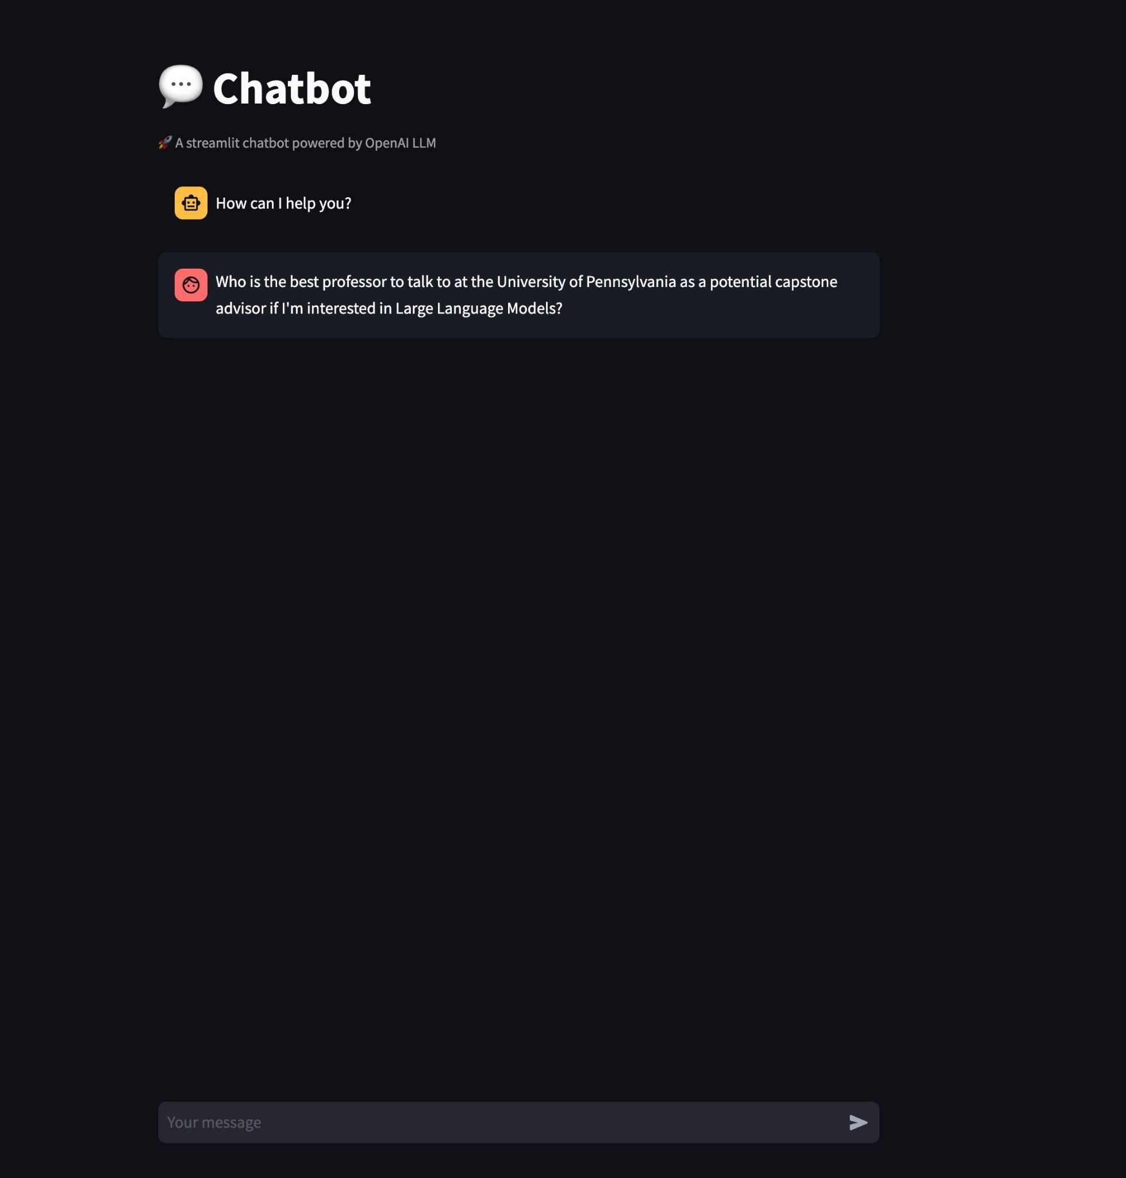
PennPalGPT
Function: Q&A ChatBot
Users: Penn students interested in research
Model: GPT-4 (gpt-4-0613)
UI: Streamlit (once completed)

Slide 3
Motivation
Utility:
Many students at Penn are interested in research
Finding the right advisor for your research interests is crucial
NLP:
Popularity of chatbots has exploded in the past 12 months
Utilize knowledge of LLMs, apply GPT models in useful setting
What we learned:
Generating features
How to group similar professors together
Fine-tuning prompt to get desired output
Intricacies of the NLP Model Pipeline

Slide 4
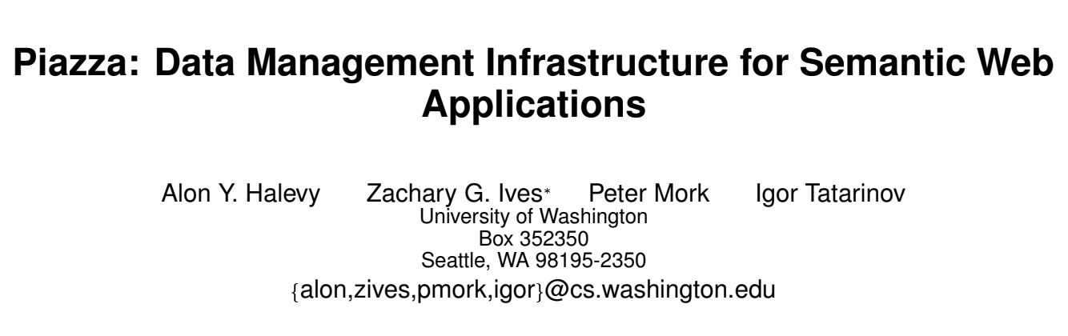
Training Data (Pretraining)
Academic papers, website bios, contact info, etc. for 102 Penn Engineering faculty in the CIS department (2410 documents in total, not including metadata)
PyPDF2 was used for text extraction
Research paper
Extraction via PyPDF2
Text file for pretraining
Document(page_content='The Piazza PeerData Mana gement Project\nIgor Tatarinov1,Zachar yIves2,JayantMadha van1,\nAlon Hale vy1,Dan Suciu1,Nilesh Dalvi1,Xin(Luna) Dong1,\nYana Kadiyska1,Gerome Miklau1,Peter Mork1\n1Depar tment ofComputer Science and Engineer ing\nUniv ersity ofWashington, Seattle ,WA98195\nfigor,jayant,alon,suciu,nilesh,lunadong,ykadiysk,gerome ,pmor kg@cs .washington.edu

Slide 5
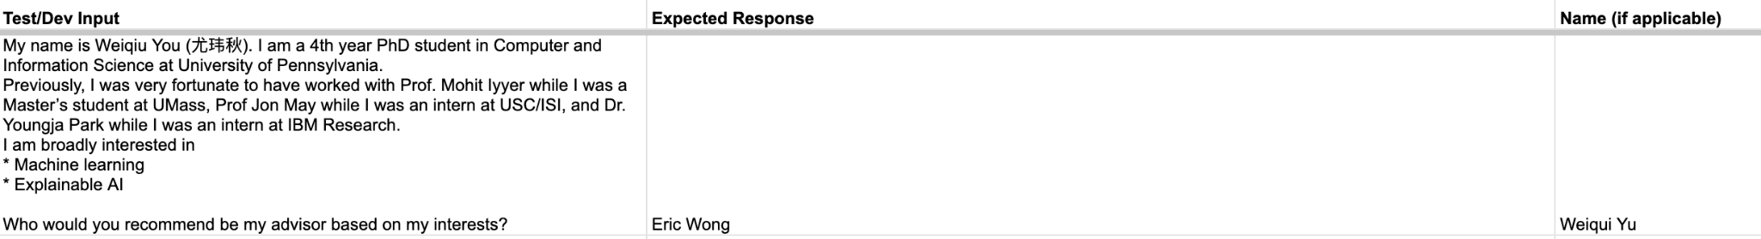
Dev/Test Data
Description: Each dataset contains 50 examples (input, answer)
Source: Research interests from PhD students at Penn (input), and their actual advisor (answer)
Dev set function: fine tuning
Test set function: evaluation

Slide 6
Models Leading Up to Final Model
Simple Baseline
Model: GPT 3.5 Turbo, msmarco-bert-base-dot-v5 embeddings
Quality: relevant, grammatically correct, very unhelpful
Strong Baseline
Model: GPT 3.5 Turbo 16k, same embeddings
Quality: much more helpful and accurate
Concept Bottleneck Model (Yang et al., 2023)
Advantage: Increase interpretability of results, identifies key features
Disadvantage: Less accurate
Variations:
Random Forest
SVC
KNN
Notes:
Concept Bottleneck Inspiration source: Yang, Yue, et al. “Language in a Bottle: Language Model Guided Concept Bottlenecks for Interpretable Image Classification.” ArXiv.org, 25 Apr. 2023, arxiv.org/abs/2211.11158.

Slide 7

Evaluation Metrics
Quantitative:
Each answer is scored 1-5 depending on how similar the chatbot answer is to the golden standard answer
We take into account if the outputted professors are in the same groups
Given our set of scores S = {s₁, s₂, … s_{n}} and the probability of each score is p(s_{i}), we calculate the final score as follows:
Qualitative:
Evaluating quality of the response
Understandable
Grammatically error-free
Valid answer
Interpretability (justification of choice)
Inspiration: Liu et al. G-Eval: NLG Evaluation using GPT-4 with Better Human Alignment

Slide 8
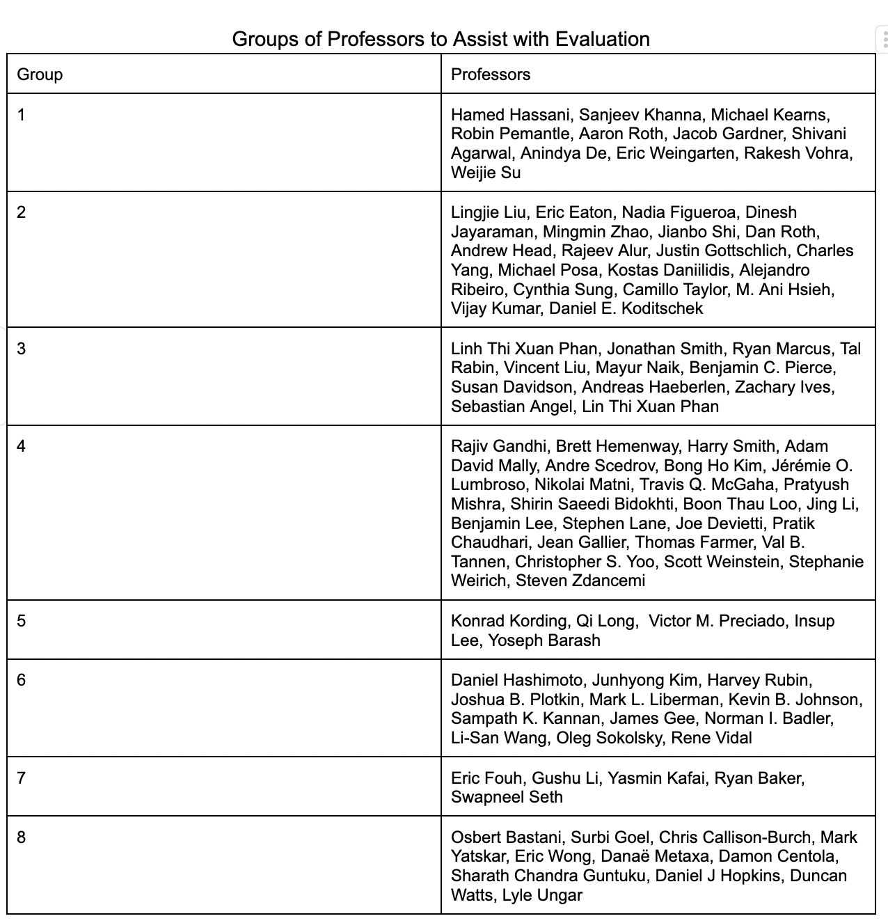
Used K-means++ to help us find these groups

Slide 9
Concept Bottleneck Model Approach
Hand-select features and create dataset of professors
Train a supervised model on the professor data and predict the professors that align closest with a question.
Feature Generation
Transform questions into vectors
Evaluation
Train an unsupervised model to assist with professor grouping

Slide 10


Final Model Pipeline
Assigns a score between 1 and 5 for each chatbot answer compared to its golden answer and a final answer between 0 and 1
Train a KNN model on the professor data, where each professor corresponds to a group and predict the 4 closest neighbors for a question.
Feature Generation
Transform questions into vectors
Hand-select features
and create data_professors.csv, dataset of all professors and their feature assignments
Model: gpt-4-0613
Model: gpt-4-0613
Model: KNN
Model: gpt-4-0613
Assisted us with grouping of similar professors (which helped us more score the quality of our chatbot answers)
Model: K-Means++

Slide 11
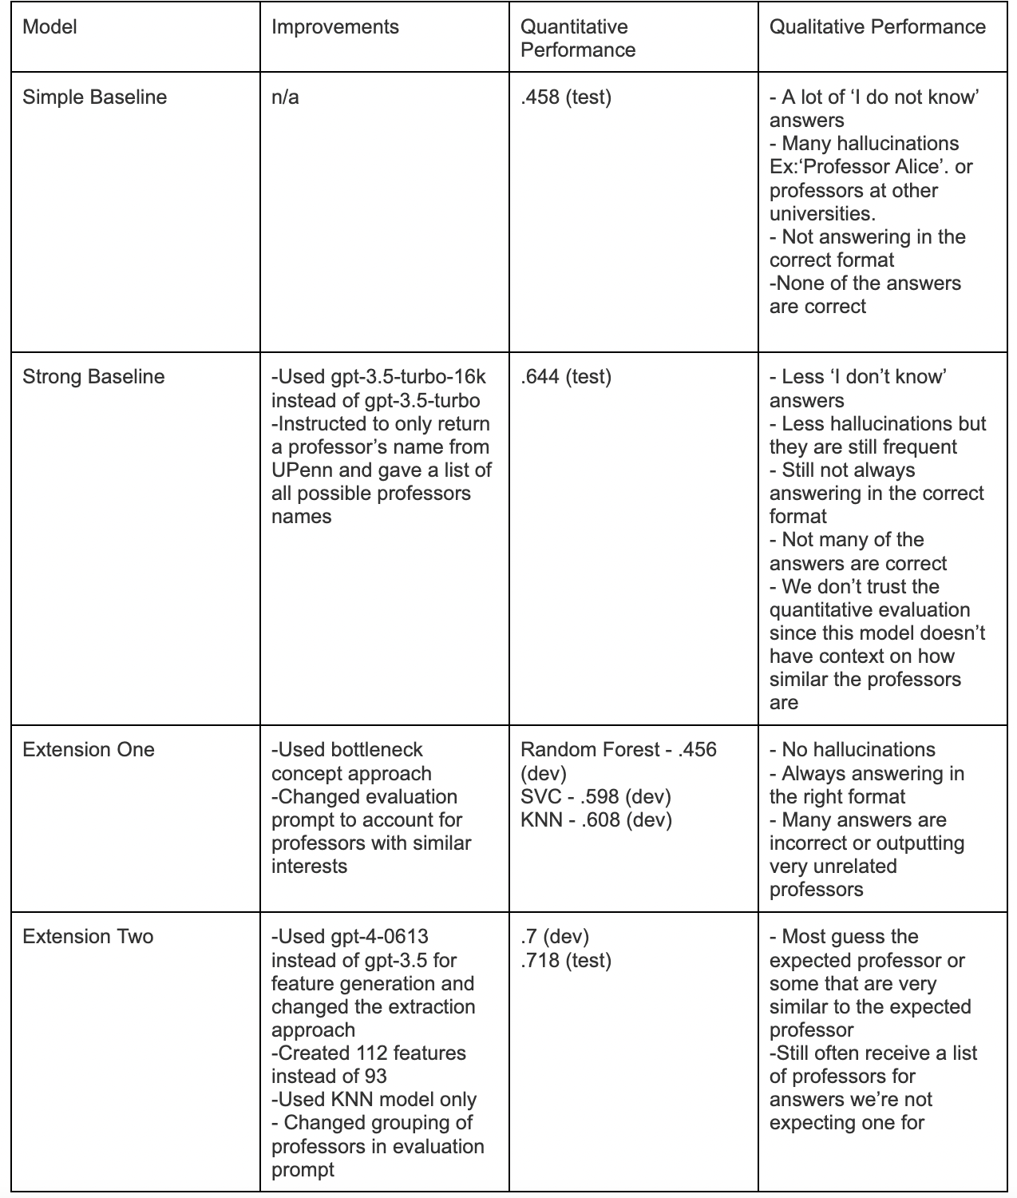

Slide 12
Future Work
Create a UI that runs our model in the backend
Allow the chatbot to output a wider array of answers
Create more features

Slide 13
Thank you for watching our presentation!

